Slide 1
Student Performance Dashboard Analysis
Data Analysis Using Excel
Zahara'u Tijjani Abdurrazak
Digital Entrepreneurship

Slide 2
Introduction
Analyzing student performance using Excel tools.
Transforms raw data into insights using dashboards.

Slide 3
Objectives
Analyze performance
Evaluate test preparation impact
Assess parental education influence
Compare gender performance
Visualize insights

Slide 4
Dataset Description
Gender, Parental Education, Lunch Type
Test Preparation, Math, Reading, Writing Scores

Slide 5
Data Preparation
Cleaned dataset
Handled missing values
Structured into table

Slide 6
Pivot Table Analysis
Compared scores by gender
Analyzed test prep impact
Evaluated parental education

Slide 7
Dashboard Development
Created charts
Added slicers
Designed layout

Slide 8
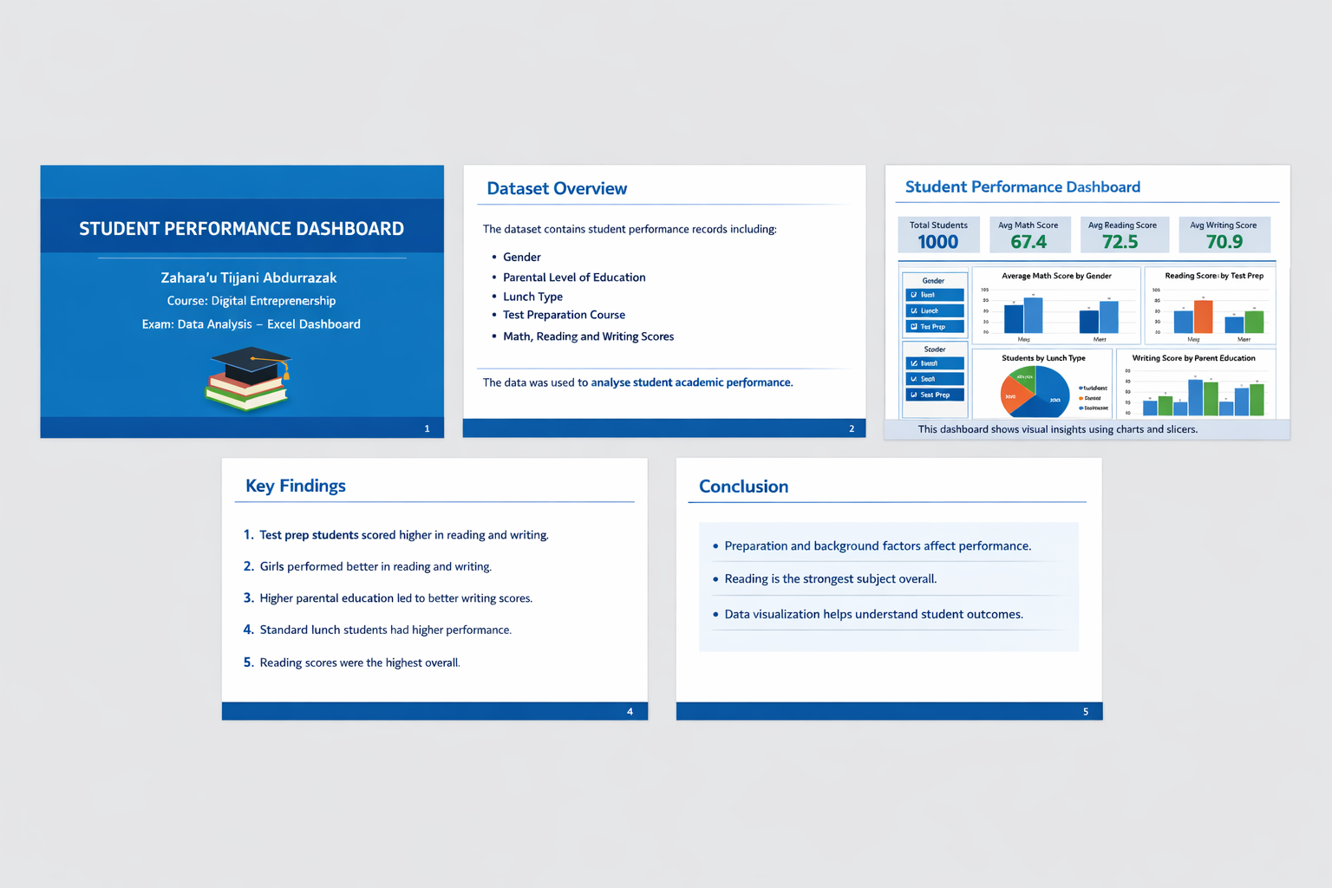
Dashboard Screenshot

Slide 9
Key Findings
Test prep improves performance
Females excel in reading/writing
Parental education matters
Reading scores highest

Slide 10
Conclusion
Performance influenced by multiple factors
Data visualization enhances understanding

